Slide 1
Welcome to the
2019 Annual Conference on
Advancing School Mental Health
Safe and Supportive Schools
for All Students!
November 7-9, 2019
Hilton Downtown Hotel
Austin, TX

Slide 2
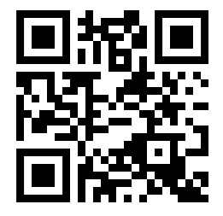
Using QR Codes
Throughout the conference, when you see a QR code, simply open your phone camera and point it at the code.
Your camera automatically recognizes the QR code and will prompt you to visit the link!
Test it out here-this one links you to the National Center for School Mental Health website.
#ASMH2019 #SchoolMentalHealth

Slide 3

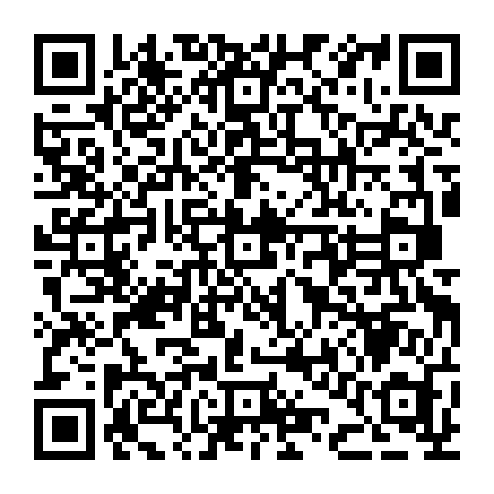

Conference Mobile App
The official conference app is available through CrowdCompass!
Download the “AttendeeHub” app in the App Store or Google Play
Once downloaded, search for the event “2019 Annual Conference on Advancing School Mental Health”
#ASMH2019 #SchoolMentalHealth

Slide 4
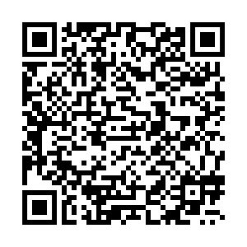
Conference Mobile App
For step-by-step instructions, on downloading, installing, and logging into the mobile app, follow the QR code to the left, or visit
bit.ly/ASMH2019app
#ASMH2019 #SchoolMentalHealth

Slide 5
WiFi Access
Network: Hilton Meeting
Password: NCSMH2019
#ASMH2019 #SchoolMentalHealth

Slide 6

Keynote Speaker, Thursday 8-9am
Dr. Isaiah B. Pickens
Chief Executive Officer
The UCLA-Duke Center for Child Traumatic Stress
Founder iOpening Enterprises
Unlocked Potential:
The Key to Transforming
the Future of Our Youth
#ASMH2019 #SchoolMentalHealth

Slide 7
Keynote Speaker, Friday 8-9am
Dr. Claire Crooks
Director
Centre for School Mental Health
Professor, Western University
Adapting Evidence-Based Practices for Specific Populations: The Intersection Between Utilizing Effective Practices and Ensuring Fit and Relevancy
#ASMH2019 #SchoolMentalHealth

Slide 8
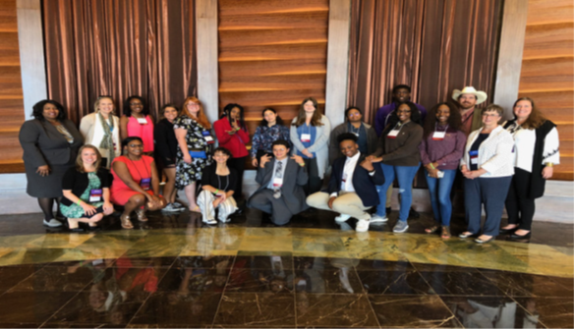
Youth Leadership Summit
Nothing about us without us!
  Hosted at the Annual Conference on Advancing School Mental Health
    Friday November 8, 2019
  Youth and young adults
  Engagement and empowerment
  Bi-directional learning
#ASMH2019 #SchoolMentalHealth

Slide 9
Exhibits
Visit the exhibits and bookstore on the 4th Floor.
Exhibits are open Thursday and Friday until 5:00 PM.
#ASMH2019 #SchoolMentalHealth

Slide 10
Visit George E. Miller II
Child Advocacy Artist in the Exhibit Hall
To view the NCSMH commissioned artwork and his other art celebrating youth, visit
www.gemartstudio.com
#ASMH2019 #SchoolMentalHealth

Slide 11
Continuing Education Credits/CMEs/CEUs
Sign in at the Contact Hours Table, located in the Foyer (next to registration), and pick up your CEU packet in order to receive your certificate.
Sign out at the Contact Hours Table end of each day.
Certificates will be mailed after the conference. You must mail your packet to the Institute of CE.
#ASMH2019 #SchoolMentalHealth

Slide 12

Evaluations
Please complete session evaluations at the end of each presentation.
Please complete the overall conference and keynote evaluations, available in the mobile app under “About > Event Info” and to be sent via email.
#ASMH2019 #SchoolMentalHealth

Slide 13
Session Room Locations
Session locations are listed on your room guide and on the conference app.
You can find a room map in the conference app by:
clicking the “Hotel and City Maps” icon, or
clicking the room name for the session (at top of session in purple)
#ASMH2019 #SchoolMentalHealth

Slide 14
Poster and Networking Reception
Friday, November 8th
5:00-6:30 pm
Location: Austin Grand Ballroom (6th Floor)
Join us for complimentary hors d’oeuvres, a cash bar, and a chance to connect with colleagues about their research!
*Poster presenters may set up their posters from 4:00-4:45 pm.
#ASMH2019 #SchoolMentalHealth

Slide 15
Box Lunch Sessions
Thursday Box Lunches can be picked up on the 6th Floor in the General Session Room.
Afterward, you may select one of the topical group or conference discussion sessions to attend.
#ASMH2019 #SchoolMentalHealth

Slide 16
Session Updates
Best Practices in School Mental Health is replacing Absent Parents Absent Kids: Increasing Attendance in High School Students Identified as School Refusing
  Thursday November 7 – 1:30 PM – 2:30 PM in Salon C
How to Create and Sustain a School-Based Mental Health Program in Your School will be replacing Fostering Immigrant Student Mental Health: Promoting Inclusion and Addressing Trauma
  Friday November 8 - 11:15 AM -12:15 PM in Salon D
Canceled: CS 6.11. Strategic Financing for Multi-Tiered School Mental Health Services
Canceled: CS 7.06 Effectively Using Data to Select, Implement, and Evaluate Tier 2 Systems
#ASMH2019 #SchoolMentalHealth

Slide 17
Session Room Changes
CS 1.12: Serving American Indian Youth with Academic and Behavioral Supports has been moved to room 400
CS 2.12: School Mental Health in the Ozarks: What works, What doesn’t has been moved to room 400
CS 3.09: Cultural responsiveness and Equity has been moved to room 400
CS 10.12: Using the School Compassionate Culture Analytic Tool for Educators to Inform the Childhood Trauma Learning Collaborative has been moved to room 404 on Friday November 8, 2019

Slide 18
Session Presenters
Speaker Ready room is available in 617.
If you did not digitally submit your presentation materials prior to the conference, please submit your slides and handout(s) at the presenter table at Registration before your presentation.
We can accept your file(s) on a flash drive or by email.
#ASMH2019 #SchoolMentalHealth

Slide 19
Presentation Slides and Handouts
Presentation slides and handouts sent by the submission deadline are posted on the NCSMH website:
www.schoolmentalhealth.org
We will upload presentations and materials received on-site during registration following the conference.
#ASMH2019 #SchoolMentalHealth

Slide 20
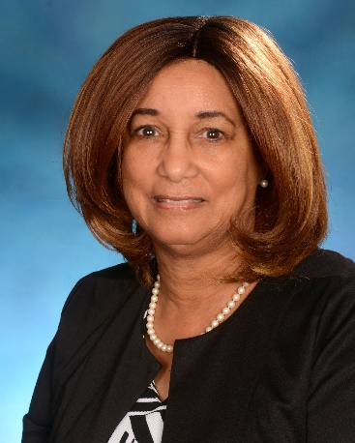
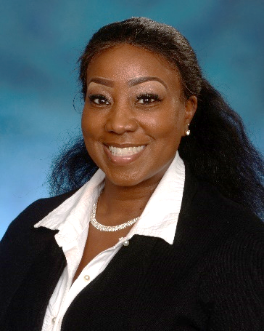
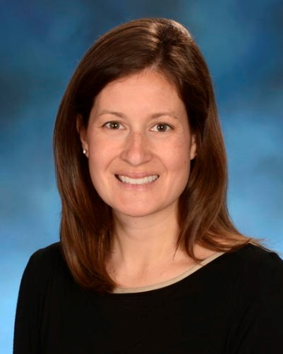
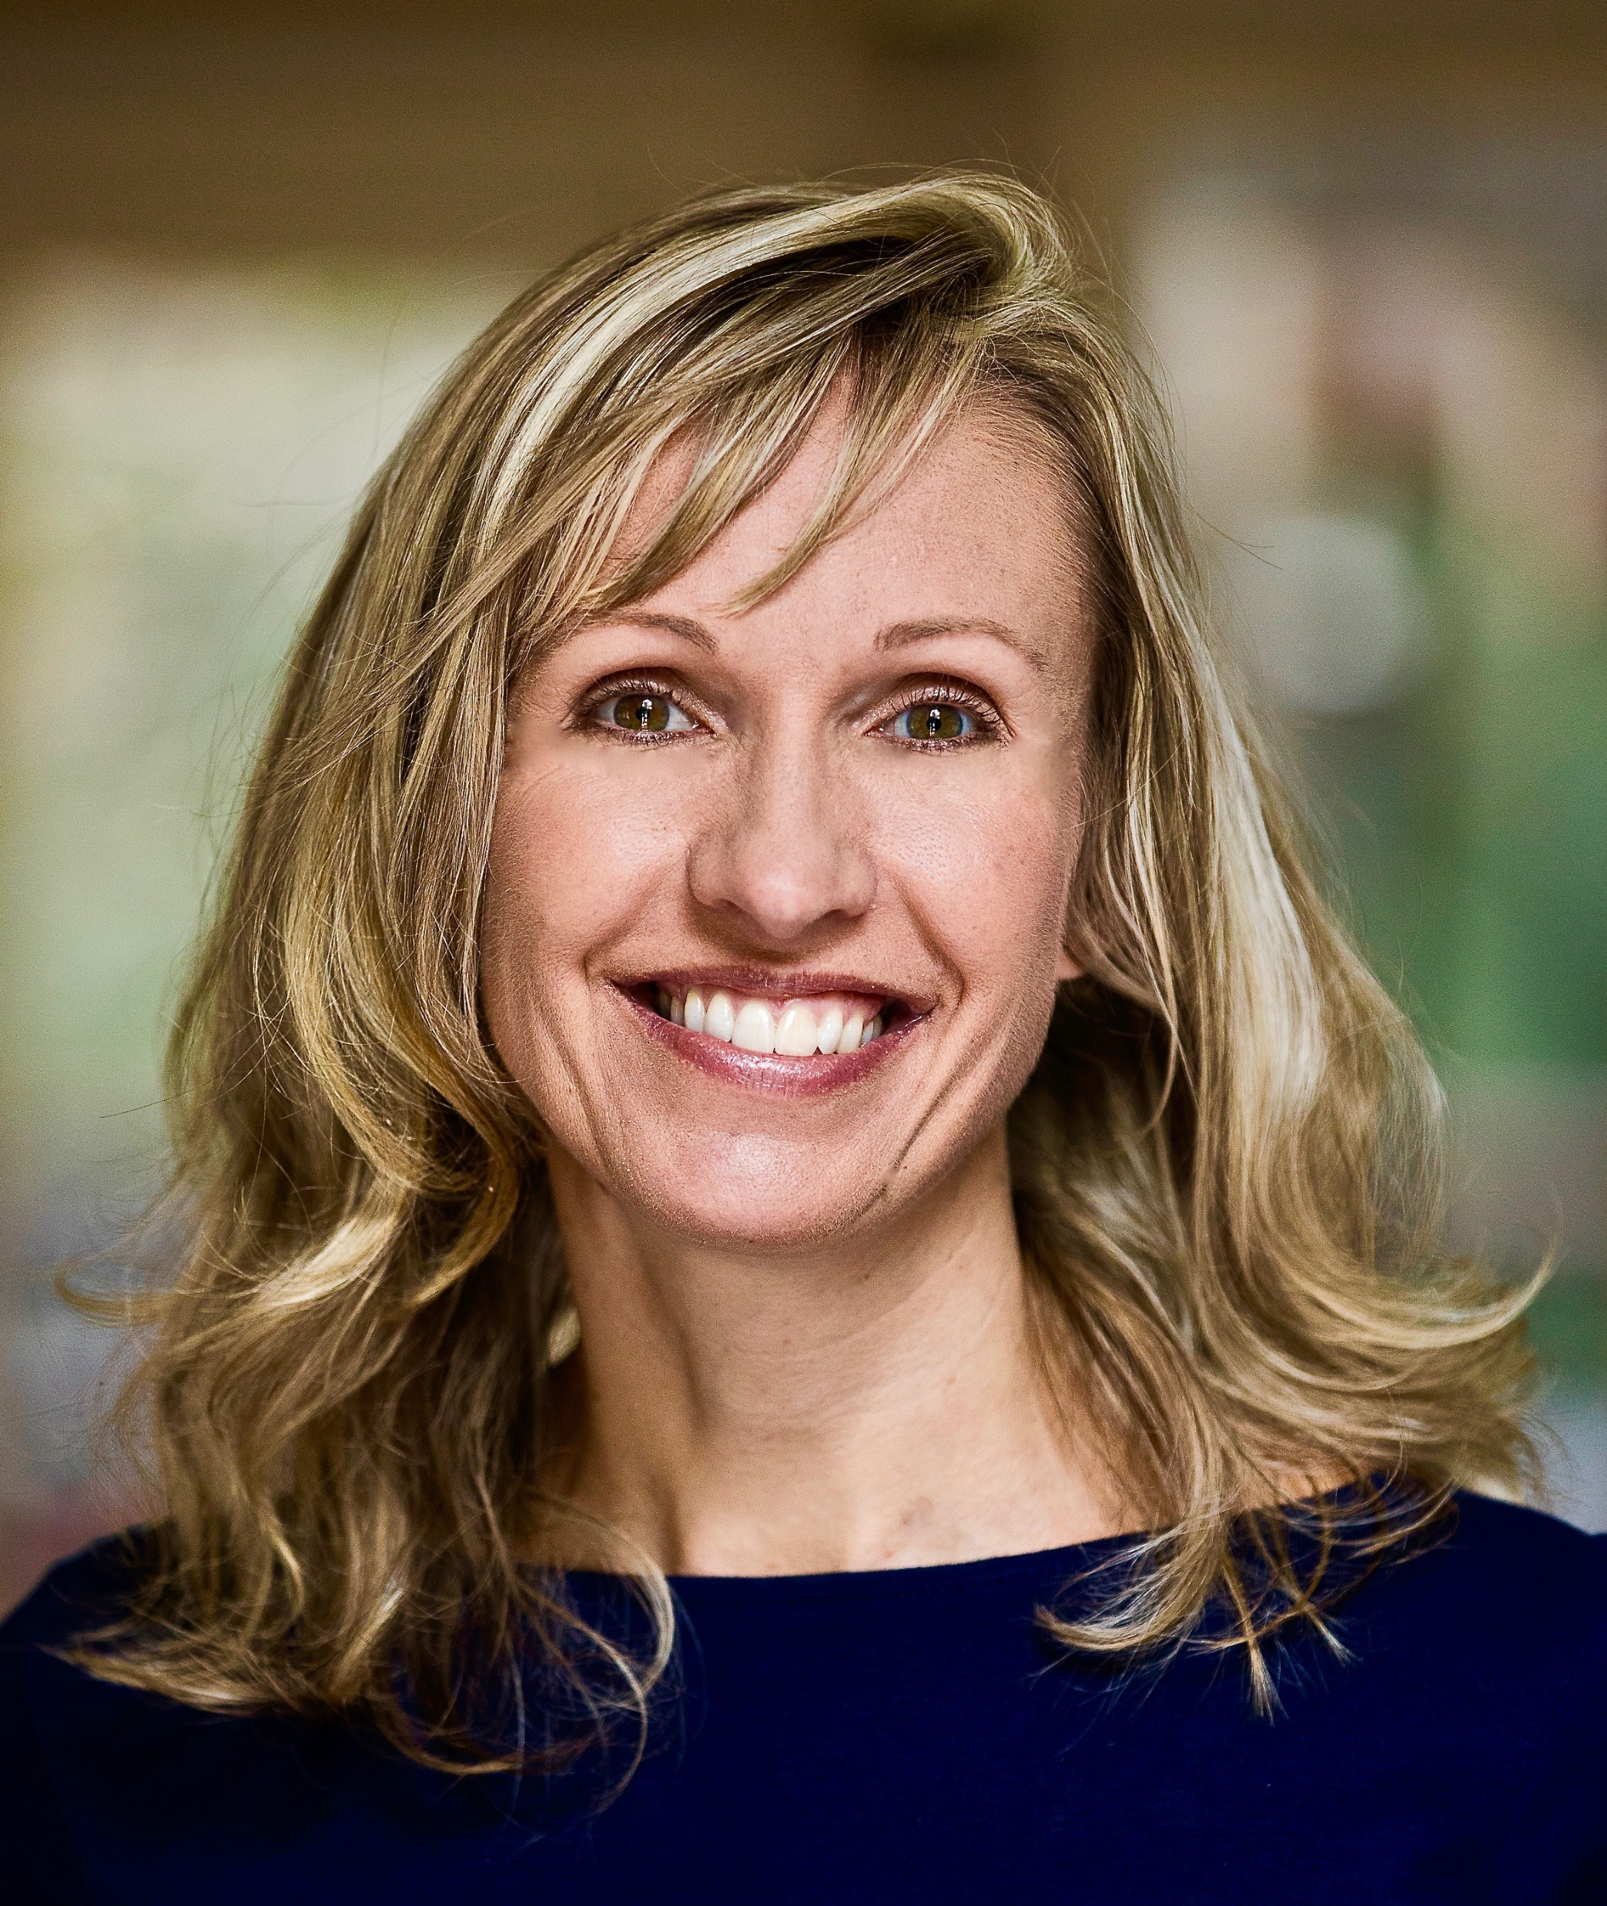
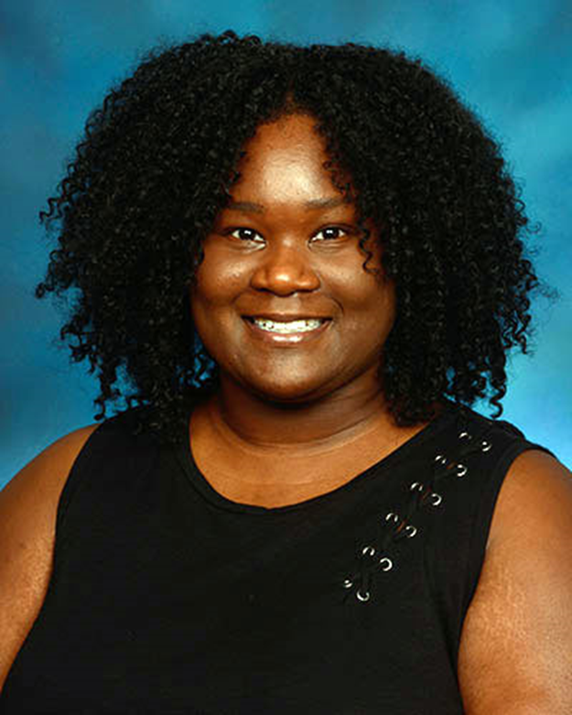
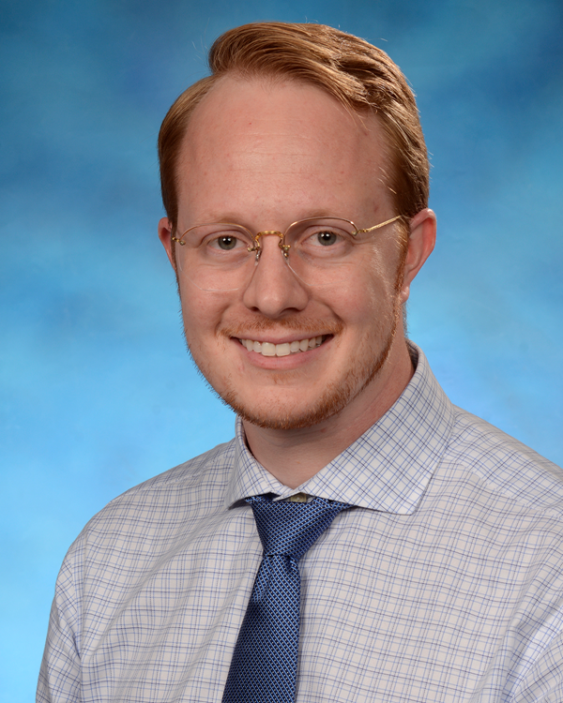
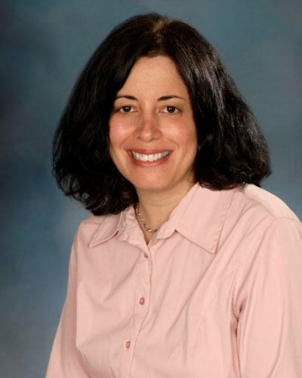
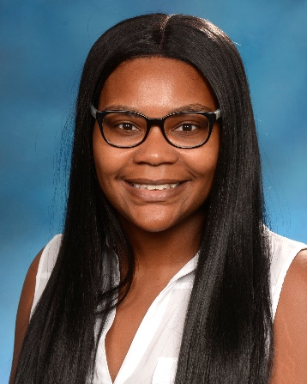
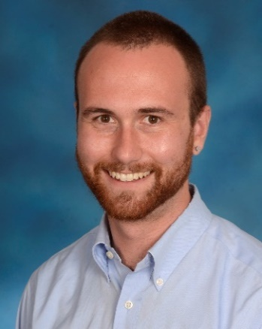
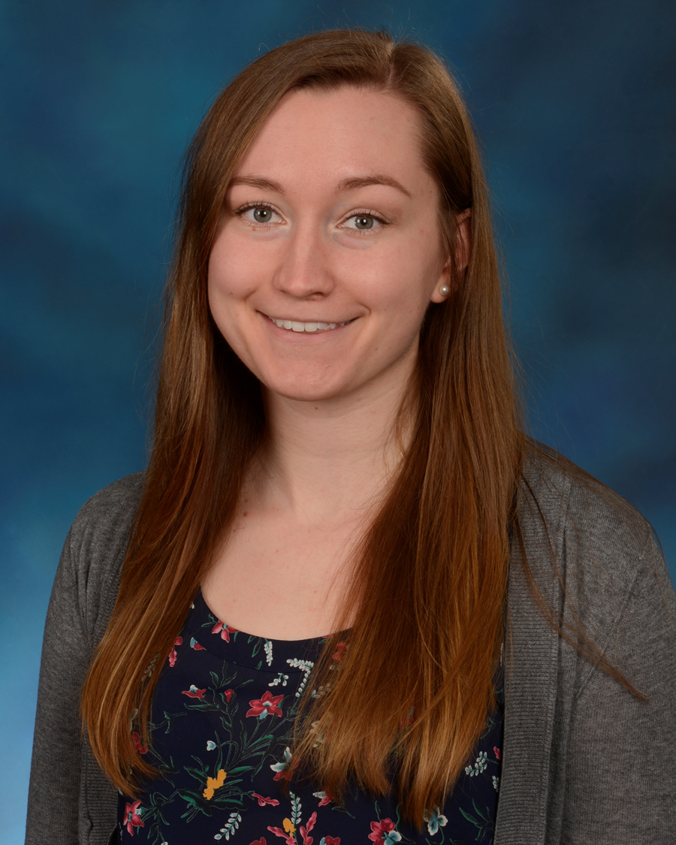
Thank you to our NCSMH Conference Team!
Sylvia McCree-Huntley, EdD
Conference Director &
Director of
Professional Development and Continuing Education
Christina Huntley, MS
Conference Coordinator
Jill Bohnenkamp, PhD
Sharon Hoover, PhD
Nancy Lever, PhD
NCSMH Faculty
Tiffany Beason, PhD
Jordy Yarnell, PhD
NCSMH Postdoctoral Fellows
Taneisha Carter, BA
Clinical Research Assistant & Conference Assistant
Perrin Robinson, MS
Research Specialist & Communications Manager
Elissa Robinson, BA
Clinical Research Assistant &
Research Summit Assistant

Slide 21
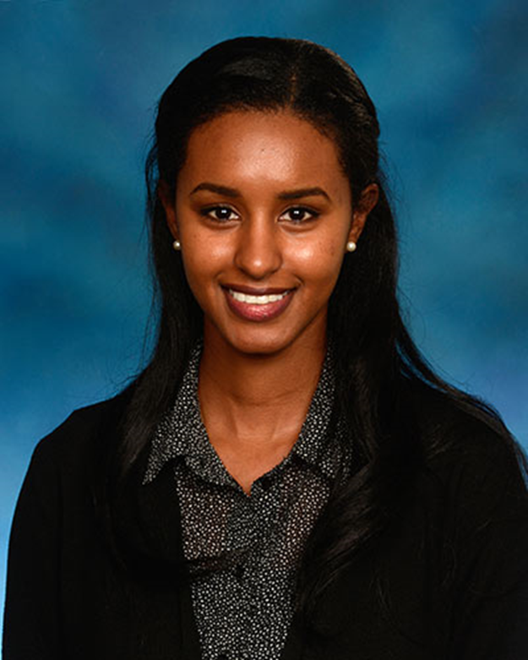
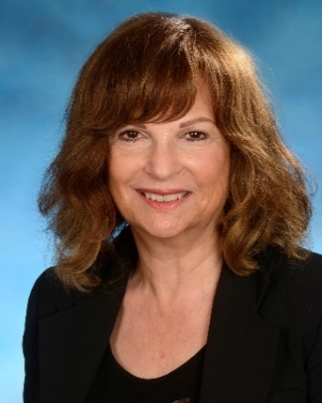
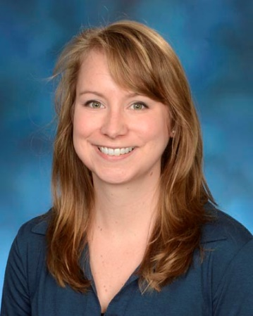
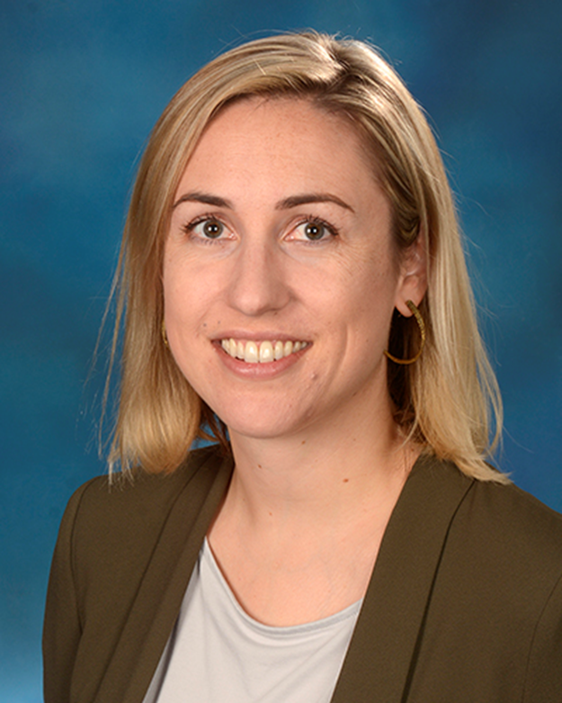
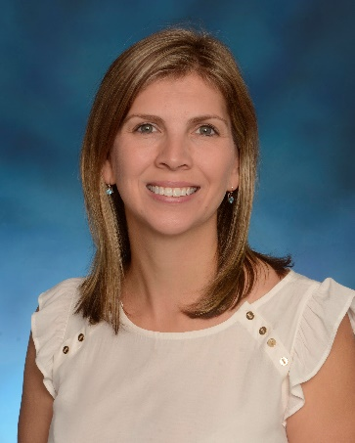
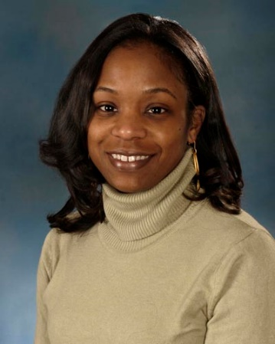
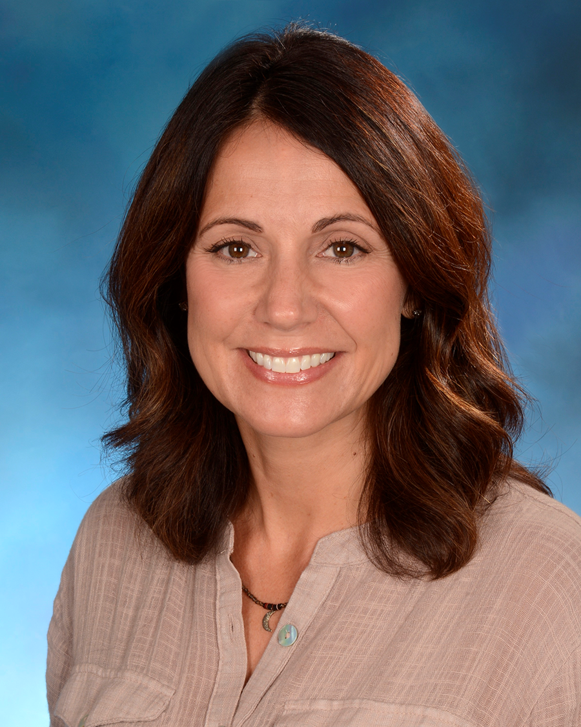
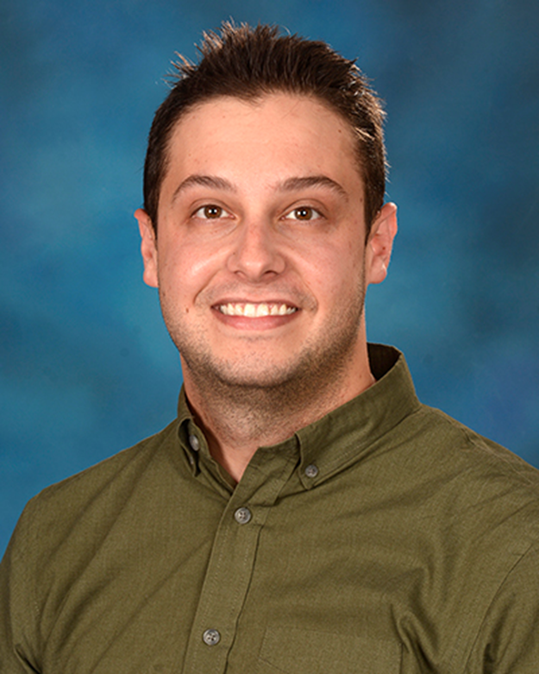
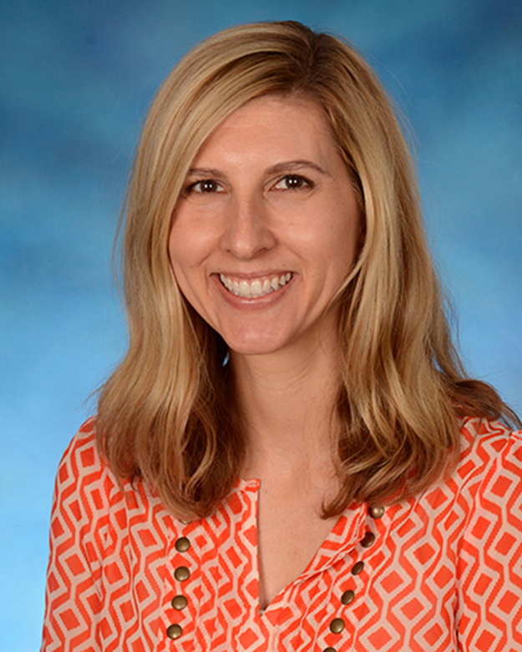
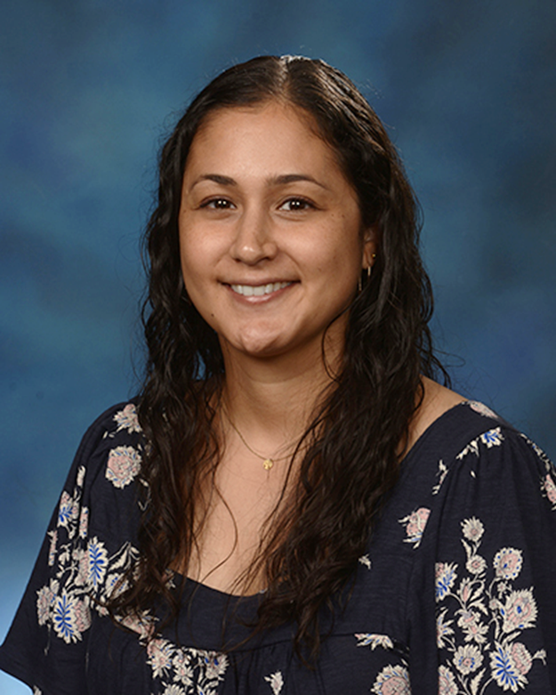
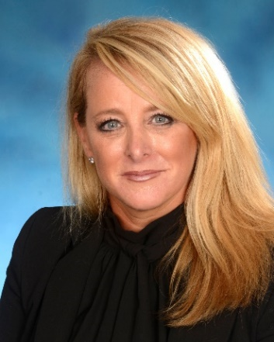
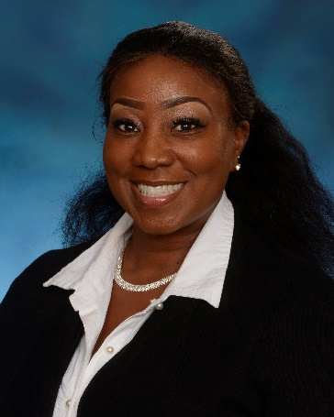
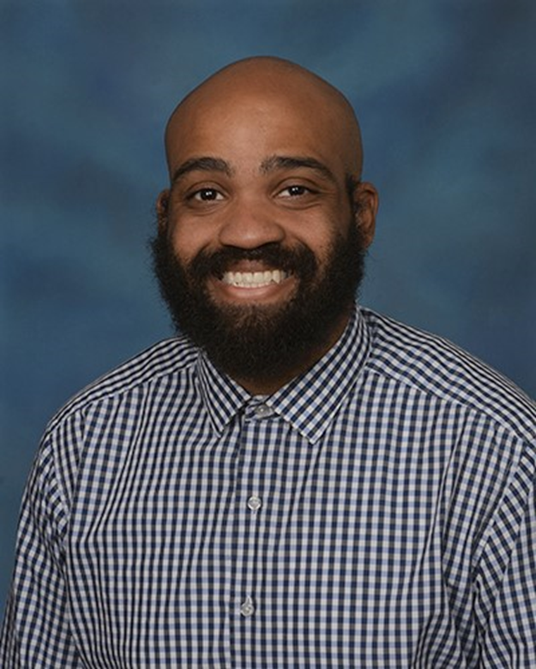
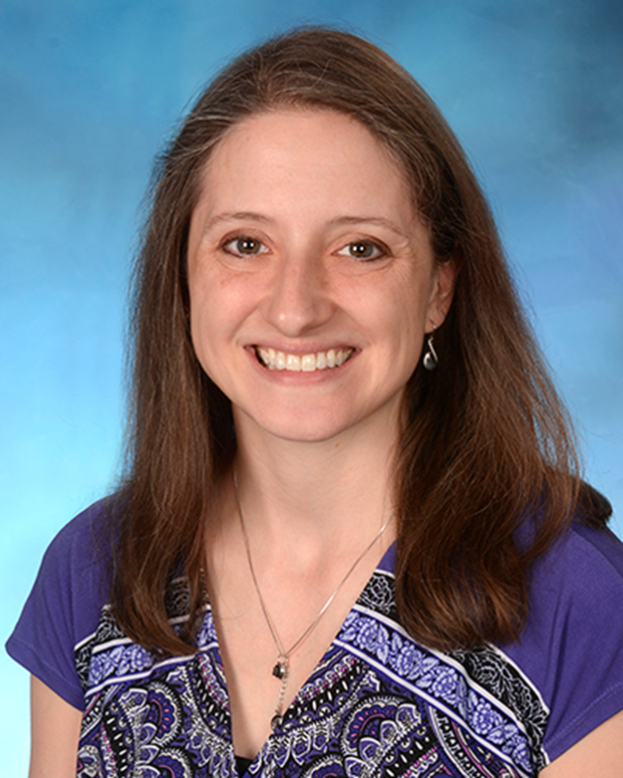
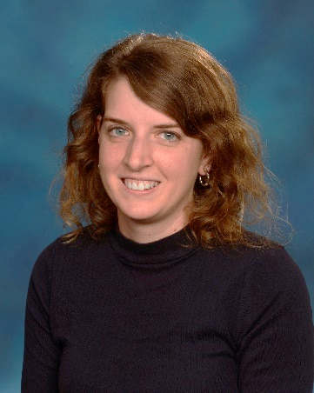
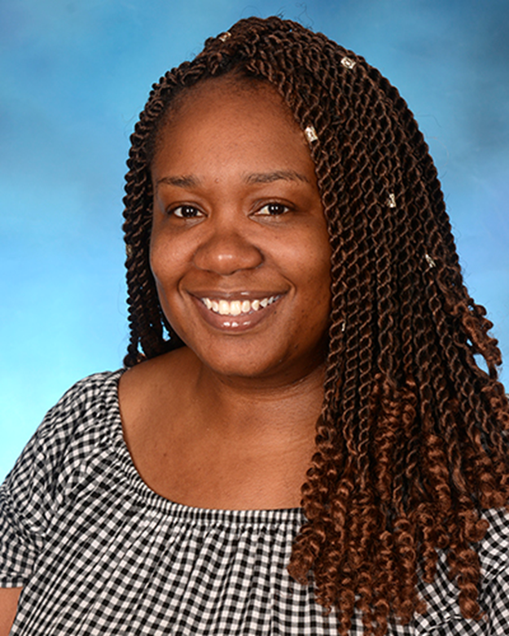
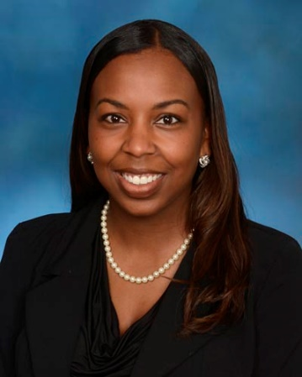
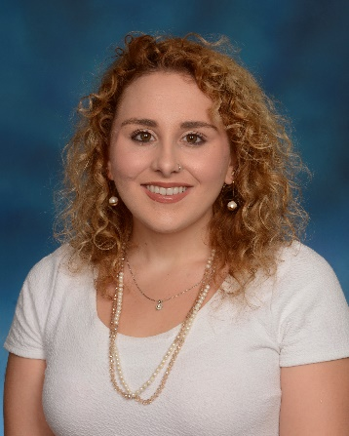
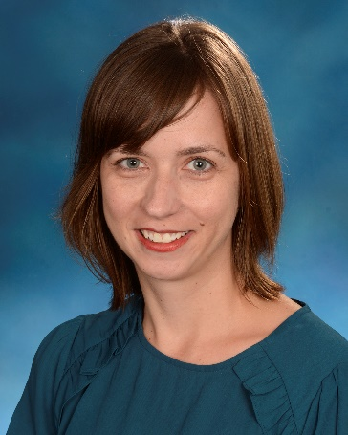
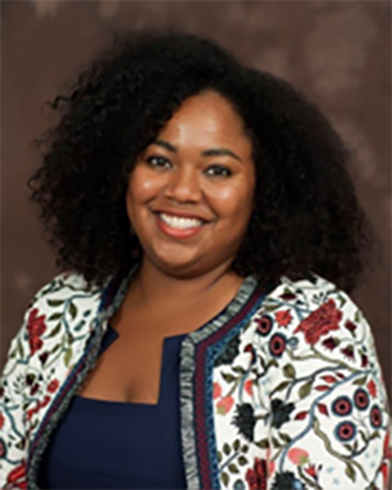

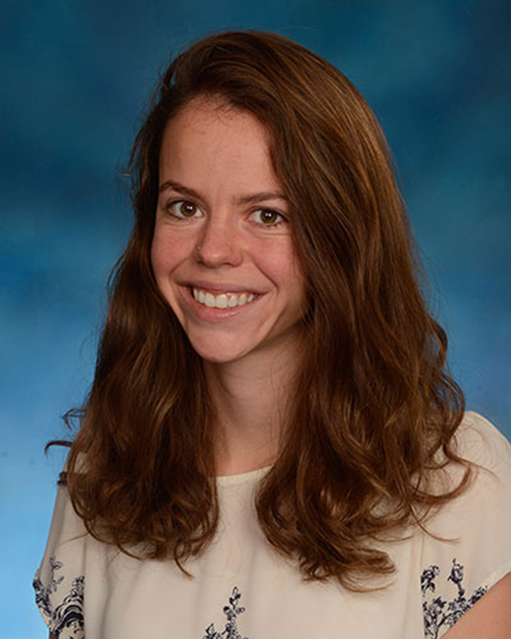
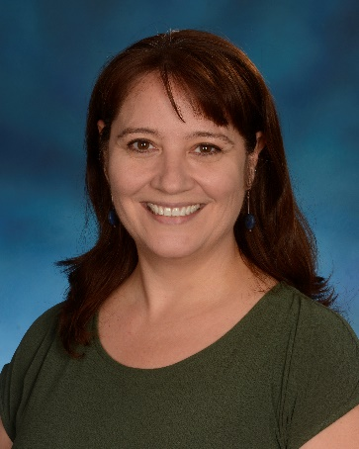
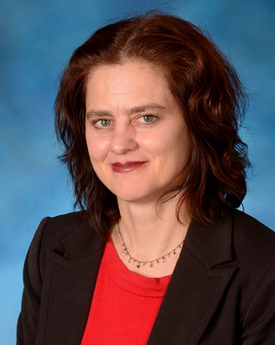
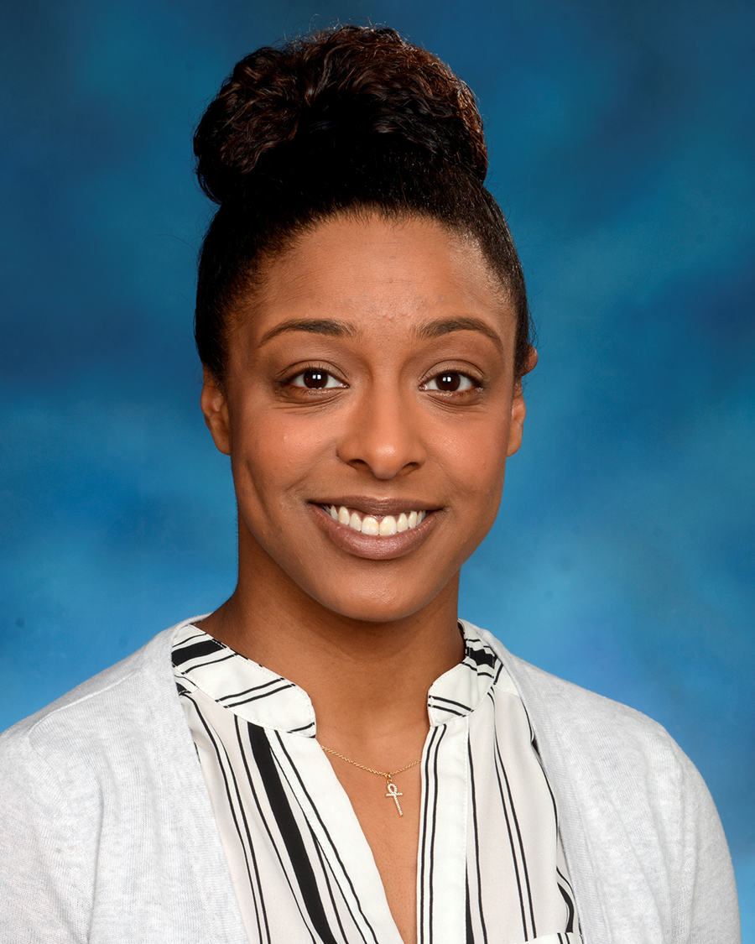
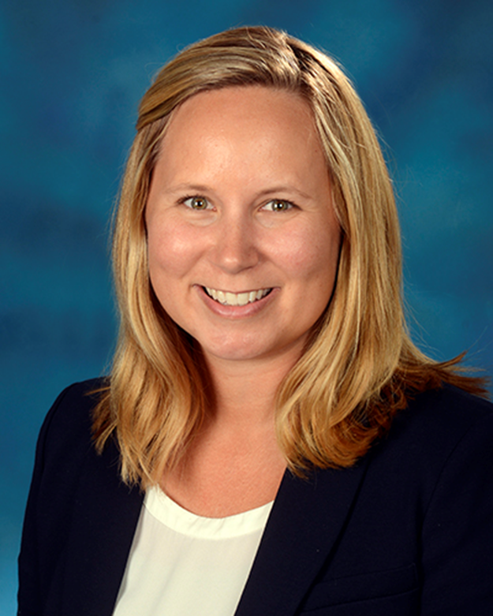
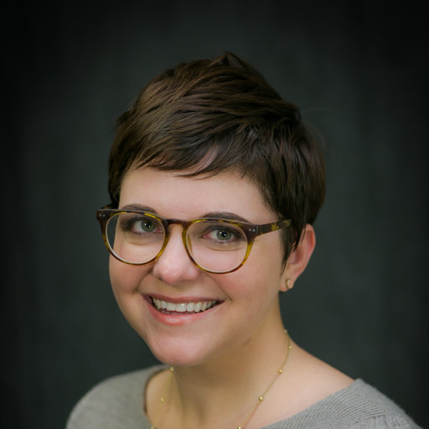
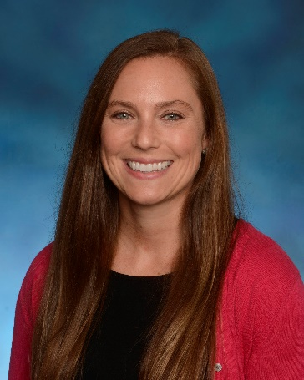

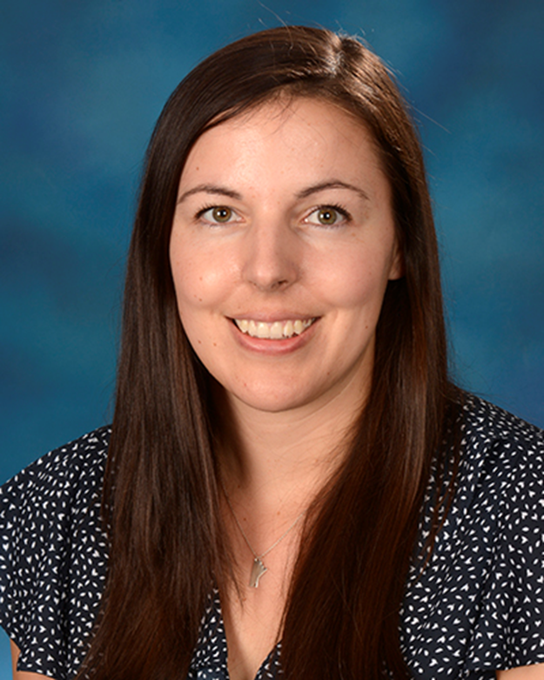
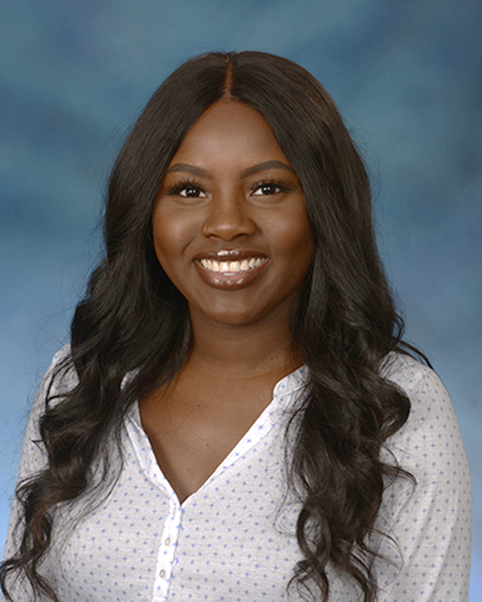
And thank you to our entire NCSMH Team!

Slide 22
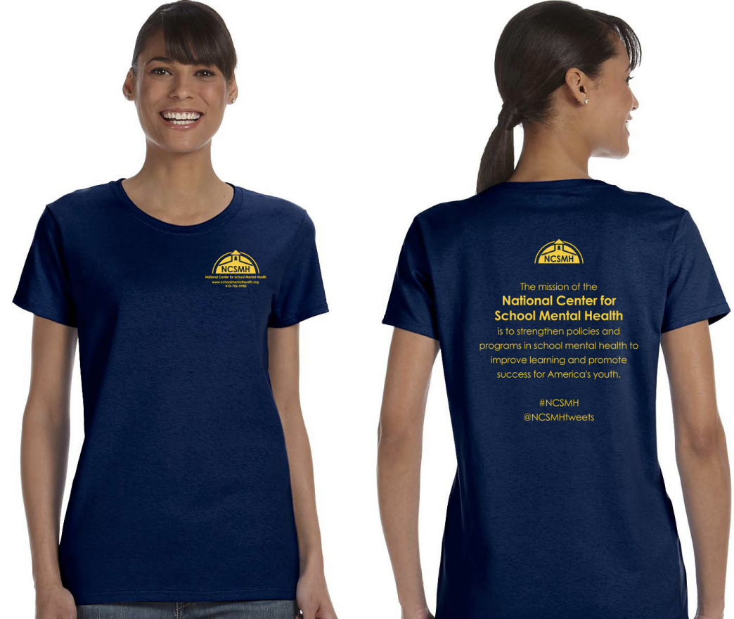
Throughout the hotel, NCSMH Team Members are wearing blue “NCSMH” t-shirts.
We are happy to assist you with room locations and other needs or concerns.
#ASMH2019 #SchoolMentalHealth

Slide 23
Thank you to our NCSMH Advisory Board!
Sharon Adams-Taylor (School Superintendents Association)
Steve Adelsheim (Stanford University)
Carol Anderson (Utah State Board of Education)
Dawn Anderson-Butcher (Ohio State University School of Social Work)
Sally Baas (Concordia, University Saint Paul)
Paul Ban (Retired School Mental Health for Military Families)
Laura Bay (National Parent Teacher Association)
Johanna Bergan (Youth M.O.V.E National)
Seth Bernstein (United Way of Palm Beach County)
Scott Bloom (New York City Department of Education)
Jeff Bostic (Medstar Georgetown University Hospital)
Joanne Cashman (National Association of State Directors of Special Education)
Caroline Clauss-Ehlers (Rutgers School of Education)
Lucille Eber (Midwest PBIS)
Steve Evans (Ohio University)
Helene Fallon (Long Island University)
Michael Faran (US Army Medical Command)
Claudette Fette (Texas Woman’s University)
Louise Fink (Baltimore City Schools)
Paula Fields (School Based Health Alliance)
Lois Flaherty (Harvard University)
Paul Flaspohler (Miami University of Ohio)
Beth Freeman (American Institutes of Research)
Julie Goldstein Grumet (Education Development Center)
Jenni Jennings (Dallas Independent School District)
Shashank Joshi (Stanford University)
Jim Koller (University of Missouri)
Ken Martinez (American Institutes for Research)
Donna Mazyck (National Association of School Nurses)
Matthew Mock (John F. Kennedy University)
Libby Nealis (National Association for Children’s Behavioral Health)
Julie Owens (Ohio University)
Janet Pozmantier (Center for School Behavioral Health at Mental Health America)
David Pruitt (University of Maryland, Division of Child and Adolescent Psychiatry)
April Rai (National Organizations for Youth Safety)
Frank Rider (American Institutes for Research)
Mark Sander (Hennepin County and Minneapolis Public Schools)
Sandy Schefkind (American Occupational Therapy Association)
Judie Shine (American Council for School Social Work)
Mary Steady (Manchester School District, New Hampshire)
Bradley Stein (RAND)
Frederick Streek (School Social Work Association of America)
Susan Tager (Mental Health Association of Maryland)
Kelly Vaillencourt Strobach (National Association of School Psychologists)
Mark Weist (University of South Carolina)
Sandra Williamson (American Institutes of Research)
Marleen Wong (University of Southern California, School of Social Work; Treatment and Services Adaptation Center for Resilience, Hope and Wellness in Schools)
Richard Wong (American School Counselor Association)
#ASMH2019 #SchoolMentalHealth

Slide 24
Thank you to our Sponsors and Exhibitors
Aperture Education
American Institutes for Research
BBBSEC
Center for Rural Health
CHCS
Child Advocacy Artist
Clinivate LLC
Committee for Children
EduMetrisis
Erika's Lighthouse: A Beacon of Hope for Adolescent Depression
Georgetown Behavioral Health Institute
Jordan Binion Project
Jordan Porco Foundation
Kaiser Permanente
Kognito
Los Angeles Education Partnership
MHTTC Network
Mindwise Innovations
National Adoption Competency Mental Health Training Initiative - C.A.S.E.
National Hispanic & Latino Mental Health Technology Transfer Center
New Spectrum Educational Consultants
Peer Health Exchange
Phoenix House of Texas
Please Pass the Love
Positive Action
PresenceLearning
Rhino Insights, Inc.
School Social Work Association of America
Southeast Mental Health Technology Transfer Center
The New York Foundling
Universidad Central del Caribe
Youth M.O.V.E National
#ASMH2019 #SchoolMentalHealth

Slide 25
Thank you to our 2019 ASMH Conference Planning Committee
Pamela Goldberg
Kevin Higley
Sharon Hoover
Christina Huntley
Rebecca Kunkel Oliver
Nancy Lever
Sylvia McCree-Huntley
Elizabeth McDermott
Julene Nolan
April Rai
Amber Reid
Perrin Robinson
Olga Acosta Price
Sally Baas
Laura Bay
Johanna Bergan
Jill Bohnenkamp
Taneisha Carter
Christine Cashman
Elizabeth Connors
Marco Erikson
Paul Flaspohler
Kaci Fleetwood
Mariola Rosser
Erica Ryst
Pat Sanborn
Sandra Schefkind
Judie Kullas Shine
Kay Taycher
Brooke Wagner
Mark Weist
David Wilkins
Sandra Williamson
#ASMH2019 #SchoolMentalHealth

Slide 26
Thank you to our wonderful Texas Conference Planning Committee
Carolyn Cole
Glenn Dembowski
Claudette Fette
Siobhan Flowers
Gregory Gorelik
Paulina Guzzardo
Tracy Levins
Molly Lopez
Keisha Martinez
Alice Alvarez
Carrie Arroyo
Betsy Blanks
Samantha Bates
Natalie Beck
Mary Beer
Betsy Blanks
Celina Bley
Jessie Brennan
Marcellina Melvin
David McClung
Elizabeth Minne
Michelle Monk
Melody Palmer-Arizola
Janet Pozmantier
Linda Rodriguez
Molly Sanders
Jeff Temple
Janet Ripperger-Suhler
Marie Welsch
#ASMH2019 #SchoolMentalHealth

Slide 27
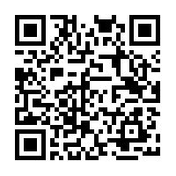
Connect with NCSMH
Subscribe to our listserv with the QR code, and follow the directions under “Subscribe”, or visit schoolmentalhealth.org
NCSMH sends an email newsletter every other month with school mental health resources, news, research, and more, as well as other timely announcements throughout the year.
#ASMH2019 #SchoolMentalHealth

Slide 28
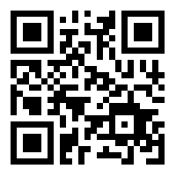
Connect with NCSMH
www.schoolmentalhealth.org
#ASMH2019 #SchoolMentalHealth

Slide 29
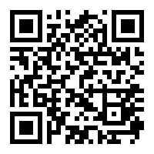

Connect with NCSMH
facebook.com/
CenterForSchoolMentalHealth
#ASMH2019 #SchoolMentalHealth

Slide 30
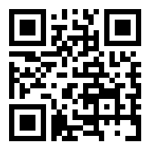

Connect with NCSMH
@NCSMHtweets
#ASMH2019 #SchoolMentalHealth

Slide 31
Connect on Social Media
Connect with us on social media throughout the conference!
Use the hashtags #ASMH2019 and/or #SchoolMentalHealth when posting about the conference on Twitter or Facebook. We are following along and love to interact with you!
#ASMH2019 #SchoolMentalHealth

Slide 32

2020 Annual Conference
on
Advancing School Mental Health
October 29-31
Celebrate 25 years with us at the
Marriott Baltimore Waterfront Hotel in
Baltimore, Maryland
#ASMH2019 #SchoolMentalHealth

