Slide 1
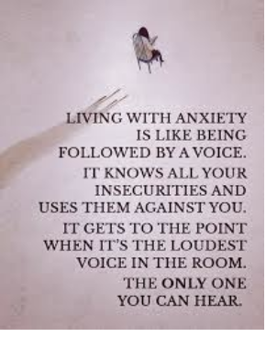
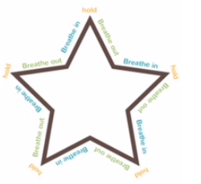
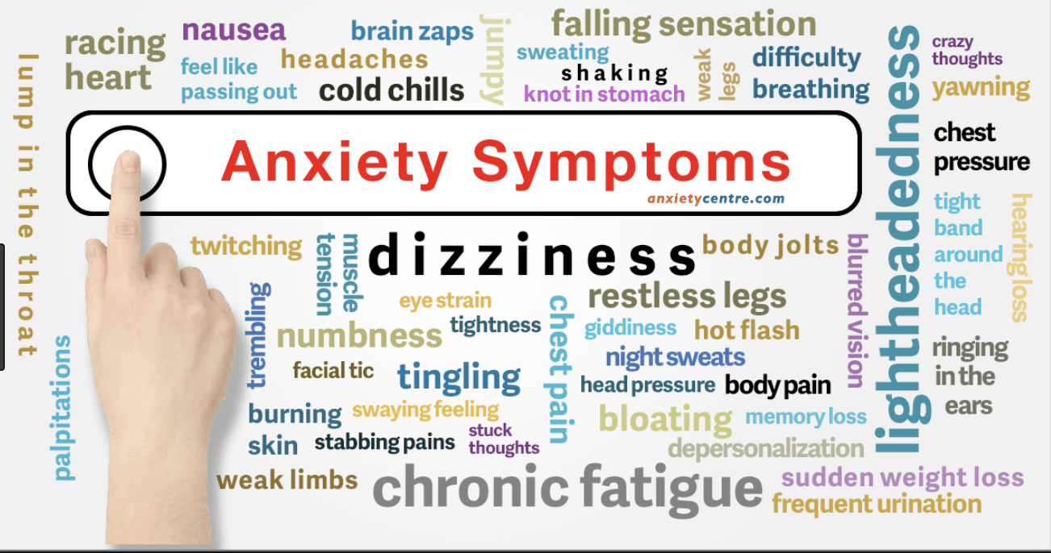
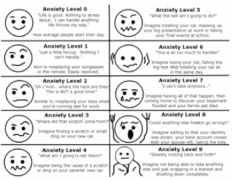
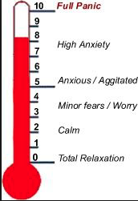
STRATEGIES TO SUPPORT STUDENTS WITH ANXIETY IN THE CLASSROOM
Presented by:
Krista Kapczynski, MS.Ed/BSL/MHFA
Amy Fichter, M.S. Autism/ABA,BCBA
What is Anxiety
“It’s OK to NOT be OK.”
Michael Phelps
Coping Strategies
Star Breathing
Anxiety Feels like…
Self Talk Scripts
Vestibular Strategies
Bouncing a ball, walking upstairs,
Repetitive tasks
Looking through a Supportive Lens…
Tools
Organized
Relationship Building to develop trust/Articulate Support
Scheduled breaks to “check out”
Increase predictability/Give Advance Notice
Behavior Momentum and “Jump Starts”
Choices and “on the spot” Modifications
Support with Organization/Environmental Considerations
Visual Supports/Support Lagging Skills/Coping Strategies
Multitasker
Team Leader
High Energy
Motivated
Consistent
Self Starter
Guidelines for an Anxiety Plan
Individual identified a SAFE person(s)?
Tool to quantify individual’s Anxiety level?
Coping Skills are of interest to the individual?
Coping skills taught and practiced “out of the moment”?
Self-Talk Statements utilized to “Rewire anxious thoughts”?
Individual returned to the activity or environment?
Data was collected on all steps of the plan?
Awareness- Decrease the STIGMA

