Slide 1
Mental Health in Teacher Ed. Programs
Center for Mental Health Conference - October 2020
Paul Stromberg, Canaan Bethea, Elizabeth Levine Brown, Katherine Phillippo

Slide 2
Rationale
U.S. P-12 students face a variety of mental health concerns that stand to jeopardize their well-being and achievement.
Teachers stand in the position to provide first-line support to the young people they see daily (Reinke, Herman, & Newcomer, 2016; Schonfeld et al., 2015).
Literature emphasizes the necessity of teacher preparation to address student mental health issues in schools (Mazzer & Rickwood, 2015; Phillippo, 2013; Phillippo & Kelly, 2014; Phillippo & Blosser, 2017; Reinke et al., 2011; Ringeisen et al., 2016)
Notes:
Mental health has been defined as a state of well-being by the World Health Organization (WHO)
School mental health intervention programs include guidance for teachers as they engaged alongside school-based mental health professionals with student mental health issues (Not uniformly applied to all teacher preparation)

Slide 3
Rationale
Scholars also voice concern about the absence of opportunities for teacher learning in this area (Graham et al., 2011; Koller & Bertel, 2006; Mazzer & Rickwood, 2015; Oberle & Schonert-Reichl, 2016)

Slide 4
Our Team’s Research: Mental Health and Teacher Prep.
Mental health-related certification standards in U.S. and Canada are limited (Brown et al, 2019).
Researchers should collect information about teacher certification programs in states that have the most standards for mental health training (Brown et al, 2019).
Tennessee, Virginia, and Florida
Generalist teachers less often encountered mental health training than specialist teachers (ESL, Special Education, Health, Ect.)
Notes:
Some provinces and states provide higher standards of preparation to address students’ mental health than others (Brown et al, 2019).
Many states did not provide significant standards of mental health interventions for teacher certification programs (Brown et al, 2019).

Slide 5
Study Purpose
The purpose of this study is to explore the mental health training provided by teacher certification programs in hopes of understanding how well future teachers are being prepared to deal with student mental health.

Slide 6
Research Question
How do teacher education programs prepare candidates to address student mental health?
Notes:
Secondary Driving Questions:
How does program leadership and/or faculty determine mental health program and course content?
What organizations drive mental health training in teacher education programs?
Where does mental health content “end up” in programs (e.g., courses, practicum, online components)?
How do instructors teach about mental health?
What do prospective teachers learn about mental health?
How do prospective teachers prepare to manage the mental health of their future students?

Slide 7
Methods
Comparative study of teacher certification programs in 3 states:
States with a relatively high number of mental health certification requirements (Brown et al., 2019).
Schools with multiple programs (generalist + at least 4 specialties) with corresponding mental health certification requirements
Development of mental health key words
Syllabi collection and analysis

Slide 8
Research Timeline
Identified states with the highest number of mental health standards: Virginia, Tennessee, Florida
Identified all teacher certification programs and required courses at those schools + collected syllabi
Interview university faculty and instructors to figure out what is being actually taught and why
Identified all Schools of Education in those states on U.S. News and World Report top 200 List
Built a list of mental health key words and searched for instances of those words in collected syllabi
Evaluation teacher prep. programs for supporting student mental health needs
Notes:
Boxes in red have not yet been completed.

Slide 9
Mental Health Key Word List:
Abuse/child abuse
Addiction/addictive
Alcohol
Anxiety
Addiction/addictive
Attention Deficit Hyperactivity Disorders/ADD/ADHD
Autism/Autistic Spectrum Disorder
Behavioral conduct; behavior management
Bias or Discrimination
Body image
Bullies; bullying
Climate (classroom or school)
Collaboration
Conflict resolution
Coping
Crisis/crises
Culture/cultural
Depression
Development (cognitive, emotional, intellectual, personal, physical, social, neurological)
Disorders/psychological diagnoses
Distress
Drugs
Eating disorders
Emotion...
Notes:
Built this list using interdisciplinary expert feedback
Looked for these keywords in the syllabi we collected
Example of sample data to follow

Slide 10
George Mason University
Early Findings From Syllabi

Slide 11
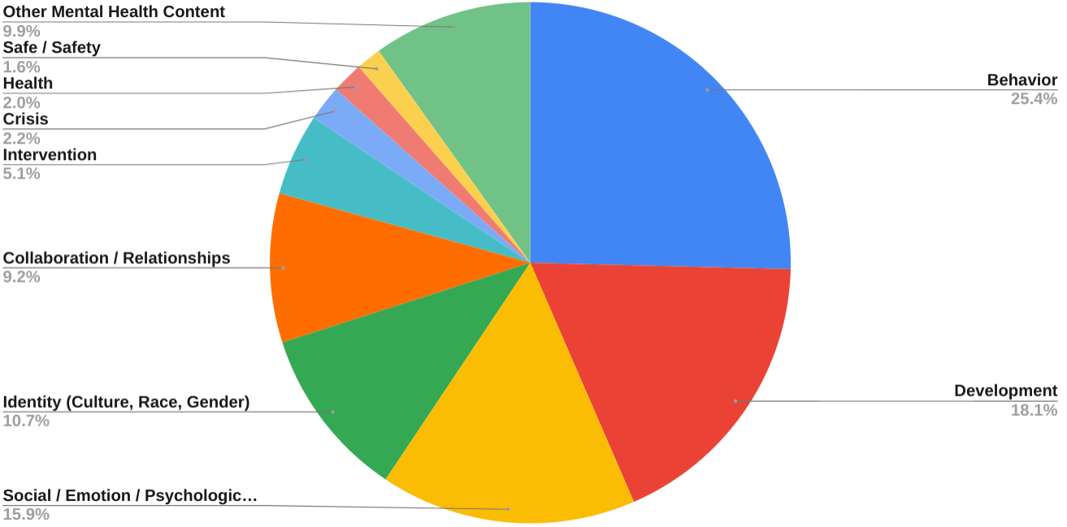
George Mason Special Education Syllabi Data

Slide 12
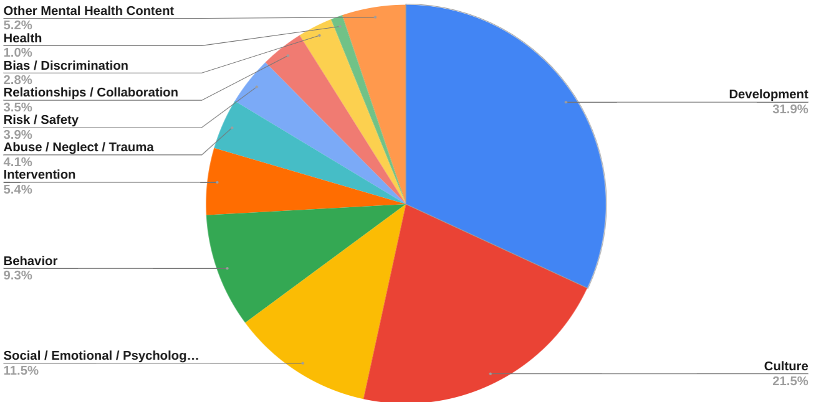
George Mason Early Childhood Ed. Syllabi Data

Slide 13
Discussion
Most mental health content seems to appear in early childhood and special education programs
Seems to be a stronger emphasis on behavioral management and child development than most other areas
Implications for what is valued in education
Need to understand perspectives of university students, instructors, and teacher placement supervisors

Slide 14
Next Research Steps
Identified states with the highest number of mental health standards: Virginia, Tennessee, Florida
Identified all teacher certification programs and required courses at those schools + collected syllabi
Interview university faculty and instructors to figure out what is being actually taught and why
Identified all Schools of Education in those states on U.S. News and World Report top 200 List
Built a list of mental health key words and searched for instances of those words in collected syllabi
Evaluation teacher prep. programs for supporting student mental health needs
Notes:
Boxes in red have not yet been completed.

Slide 15
Implications for Practice and Policy
Re-evaluation of state standards
To what degree are standards actually driving class content?
Evaluation for high-quality teaching and preparation for supporting student mental health needs

Slide 16
Questions?
Paul Stromberg --- pstromberg@luc.edu
Canaan Bethea --- cbethea4@gmu.edu
Elizabeth Levine Brown --- ebrown11@gmu.edu
Katherine Phillippo --- kphillippo@luc.edu

